Slide 1
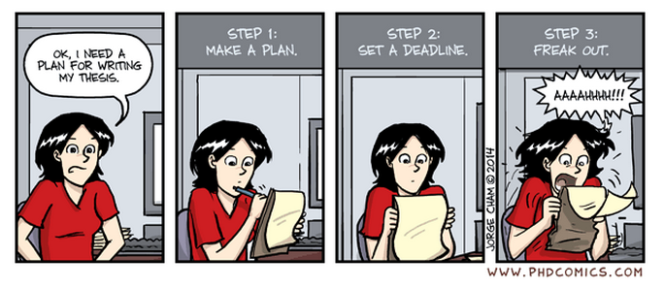

Birmingham International Academy
Thesis Writing
Thesis Writing for
Scientists and Engineers
Session 2
Tutor’s name: Jane Sjoberg
Please sit near other people

Slide 2
Monday 1 June 3-5pm
Structure/ Introductions/Academic Style)
Tuesday 2 June 3-5pm
Literature Reviews
Wednesday 3 June 3-5pm
Methods/Procedures/Active and Passive)
Thursday 4 June 3-5pm
Results and Discussion
Friday 5 June 3-5pm
Conclusion and abstract

Slide 3

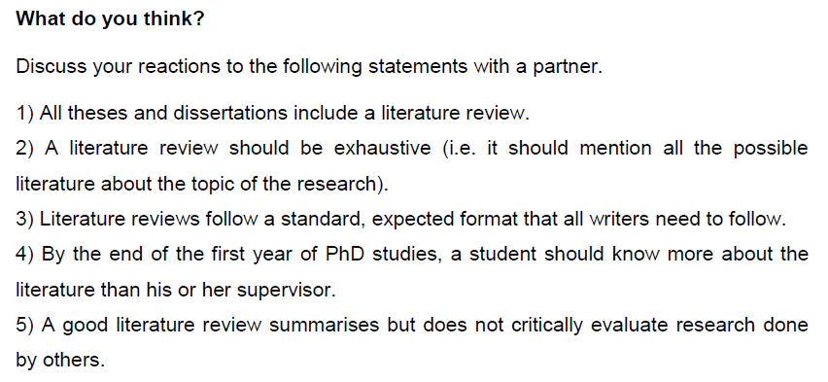

Slide 4



Task 1
Read the text that gives advice to computer science thesis writers.
Do you think the advice could be relevant to writers in your own discipline? Why/why not?

Slide 5

Why survey the literature?

Slide 6
The Literature Survey
Purpose:
to describe the research lines that you wish to follow and point out what has been done on these topics in the past/ to show how your research links to that of others

Slide 7
Where does it come in a thesis?
Task 2
Literature reviews are not always given a clear title and may be developed over more than one section.
Look at the Table of Contents from a thesis entitled ‘Taxonomies for Software Security’.
Highlight the sections of the thesis that you think will include a literature review.

Slide 8

1.2 Overview
Read the 1.2 Overview and check your ideas.

Slide 9
Key
Chapter 1, 1.3 research context
Chapter 2, Secure Languages and Tools
possibly also in Chapter 3, Flavors of Logic
Chapter 5, A Taxonomy on Layers of Abstraction.

Slide 10
Stand-alone or integrated?
In science and engineering, literature reviews can form a separate stand-alone section of a thesis.
They may be developed as part of a discussion of the state of the art.
A literature review might be part of a chronological analysis of technological developments within the introduction.

Slide 11
B: Showing Stance
What is ‘stance’?
Why is it important in research?

Slide 12

Achieving a Balance
The essential purpose of the literature survey is to describe the research lines that you wish to follow and point out what has been done on these topics in the past.
This is a difficult writing skill to learn since you have to balance the weight of your own voice or position with the many voices of other authors in your field.

Slide 13
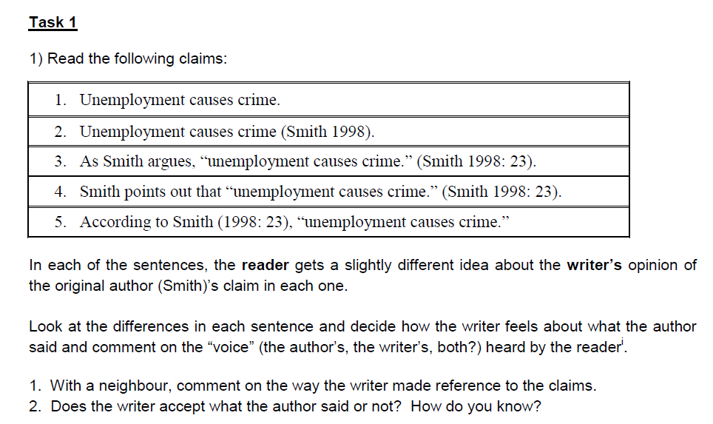

Slide 14
How the textual ‘voice’ is constructed
 | Writer | author
Unemployment causes crime.
totally present
absent
Unemployment causes crime. (Smith 1998).
dominant
subordinate
As Smith argues, “unemployment causes crime.” (Smith 1998: 23).
equal status
Smith points out that “unemployment causes crime.” (Smith 1998: 23).
subordinate
dominant
According to Smith (1998: 23), “unemployment causes crime.”
least important
most important
Writer = person writing the thesis
Author = source text (in this case- Smith, 1998)

Slide 15
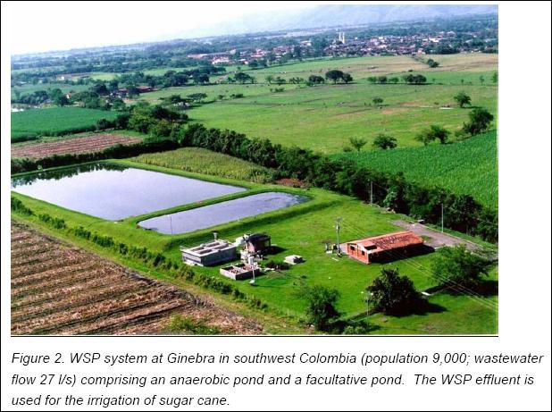
Wastewater Ponds
Source: www.web.deu.edu.tr

Slide 16
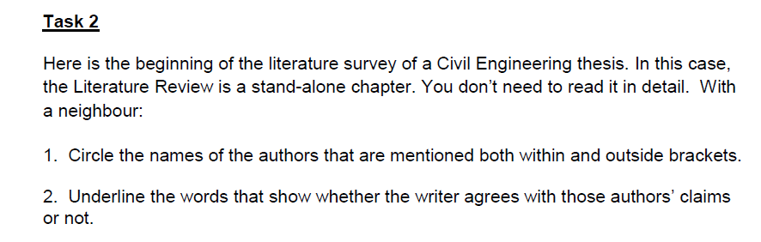
Read and Find

Slide 17
Example answers
At temperatures above twenty degrees Celsius, one day retention time is sufficient to achieve sixty percent BOD removal (Mara et al., 1992a). [simple present, writer agrees]
Closer to the surface it is possible that strict aerobic bacteria exist, although research on this is limited (Mara, 1997). [mostly agrees: cautious claim / simple present]
Even shallower ponds have been tested at the EXTRABES research station in Brazil, although Mara (1997) believes that [writer not sure there is enough evidence] at these reduced depths emergent plant growth and mosquito breeding problems can result.

Slide 18

Check other answers in the Key!
The indication of stance or how you communicate your point of view regarding the literature cited (basically indicating whether you agree, disagree or are neutral about it) depends on the verbs and other reporting structures that you use.
This kind of activity is a good one to practise as you read in your subject. Highlight citations and reporting strategies and think about the author’s stance.
Consider the way in which you present the work of others. Do you really mean to be neutral?

Slide 19
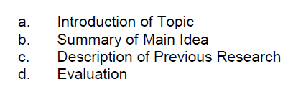
C: Steps in the Literature Survey
Yesterday we looked at typical steps in introductions.
There are typical repeated steps in literature surveys, too.
Read the two examples of two consecutive paragraphs that follow this structure.
Remember that authors sometimes change the order of these steps and may begin with a summary of research before introducing the main topic.

Slide 20
Task 1
Can you identify the same steps in the following short extract from a journal article ?
Systematic genome-wide gene deletion collections of eukaryotic organisms provide powerful tools for investigating molecular mechanisms in basic biology and for identifying pathways that can be targeted in bioengineering or medical applications, as shown by pioneering studies with the budding yeast Saccharomyces cerevisiae1, 2, 3, 4, 5. The construction of systematic gene deletion collections is difficult, although RNA interference (RNAi) provides a popular alternative approach to ablate gene activity in many organisms.

Slide 21
KEY
[A] Systematic genome-wide gene deletion collections of eukaryotic organisms [B] provide powerful tools for investigating molecular mechanisms in basic biology and for identifying pathways that can be targeted in bioengineering or medical applications, [C] as shown by pioneering studies with the budding yeast Saccharomyces cerevisiae 1, 2, 3, 4, 5. [D] The construction of systematic gene deletion collections is difficult, although RNA interference (RNAi) provides a popular alternative approach to ablate gene activity in many organisms.
NB: ‘Evaluation’ does not only mean a critical comment on the literature cited (positive/negative). It might be a suggestion of how limitations in cited research are overcome/also faced by others OR could involve relating specific aspects of work cited to your own research (e.g. using a variation of a method proposed)

Slide 22
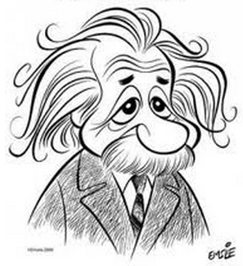
D: Language for Reporting
Time is not the only issue in choosing the right tense in academic writing.

Slide 23
1. Introducing Research – Neutral Orientation
The usual “introducing” tense in a literature survey is the Present Perfect.
Even shallower ponds have been tested at the EXTRABES research station in Brazil
Task 1
Underline the present perfect verb structures as in the following citations drawn from papers in Plant Biology and Civil Engineering.

Slide 24
KEY
1) Various agencies have attempted to create computer models to do the sam
2) one of the factors causing loss of viability in cereals has been produced by Tuite and Christersen {1955),
3) other means of rapid non-destructive pavement evaluation has been utilised by Sir William Halcrow and Partners.
4) to date have been successful. Research recently completed has tested the recipe method of mix design and has oft
5) tenable since the existence of a tertiary gene pool has been demonstrated by Newell and Hymowitz (1982)who
6) The UK Department of Transport has published a Code of Practice for the routine maint
7) seed was using up its metabolities. But more recent work has indicated that the greater part of this respirator

Slide 25

What does tense tell us?
Tense helps the reader know what you as a writer want to focus on
Author (strong/weak focus)
Topic/idea

Slide 26
PAST TENSE
2: Strong Author Orientation.
Examples:
Swales (1991), for example, proposed a structure consisting of four moves for article introductions.
Their work was expanded by Hopkins (1995) and Peng (1996).

Slide 27
PRESENT PERFECT
3: Weak Author Orientation.
Example:
A number of research workers have also considered the organisation of discussion of results sections.
In particular, several studies of NSAIDs have shown that NSAID use is associated with a reduced risk of breast cancer, especially hormone receptor–positive tumors (17, 35, 36).

Slide 28
PRESENT SIMPLE
3: Topic is the focus, rather than author
Example:
The only description in the literature of a general proposed structure is of the problem solution type (Hepworth 1988).
Smith (1997) discusses the idea that universities should teach on Saturday mornings.

Slide 29
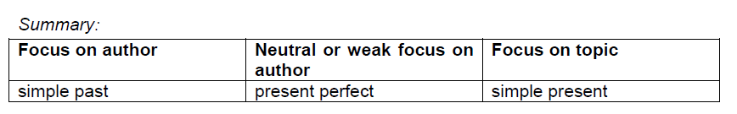
Be careful
Notice that tense use is not always related to the year of publication!
Smith (1997) discusses the idea that universities should teach on Saturday mornings.
Smith first suggested that universities should teach on Saturday mornings in 1997.
If in doubt, use present perfect or present tense.

Slide 30
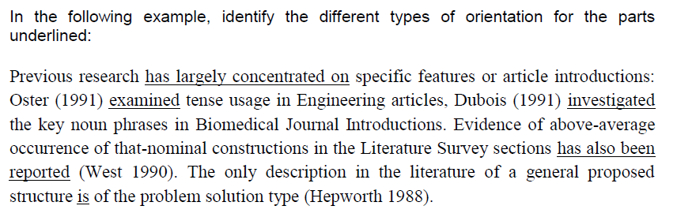
Task 3

Slide 31
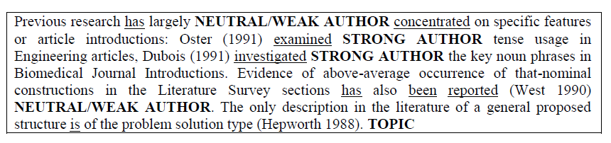
KEY

Slide 32
Reviewing the state of the art
Task 3
In science and engineering texts that review the state of the art as part of the Literature Review, a variety of tenses can be used and these again are not always related to the time of publication.
Look at the tense of the verb ‘use’ in the extract from a thesis entitled ‘Design Improvements of Micro-Tubular Solid Oxide Fuel Cells for Unmanned Aircraft Applications’ below. Why have different tenses been used?

Slide 33
KEY
The first instance is in simple present. The use of simple present focuses on topic – i.e. the method described by Sammes et al
This is the technique that was then followed by the researcher in his/her own research as indicated by ‘In this work, brazing was used’ (simple past – specific time i.e. in the research that I did).
In the second instance (Homel et al) the past tense gives more prominence to the authors with not such a clear link to the writer of the thesis and his/her own research.
‘Have also been used’ is the neutral reporting tense (in fact no author is given – the focus is more general).

Slide 34
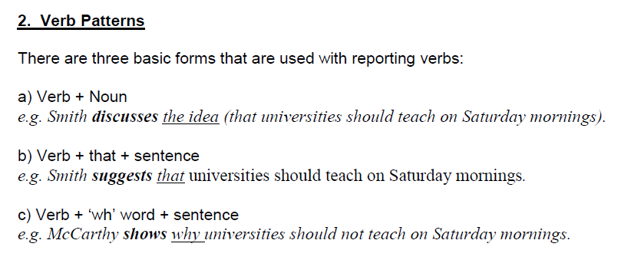
2: VERB PATTERNS

Slide 35
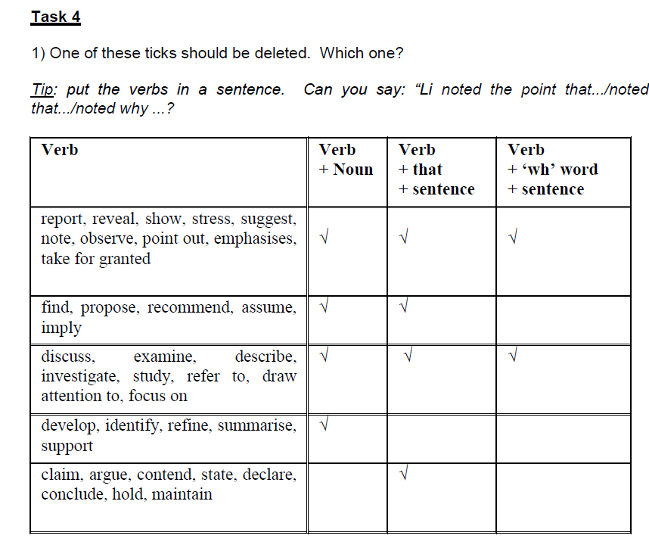

Slide 36
We can summarise the forms with the common verbs in the table below:
Verb | Verb + Noun | Verb + that + sentence | Verb + ‘wh’ word + sentence
report, reveal, show, stress, suggest, note, observe, point out, emphasises, take for granted | ☑ | ☑ | ☑
find, propose, recommend, assume, imply | ☑ | ☑
discuss, examine, describe, investigate, study, refer to, draw attention to, focus on | ☑ | ☑ | ☑
develop, identify, refine, summarise, support | ☑
claim, argue, contend, state, declare, conclude, hold, maintain |  | ☑

Slide 37
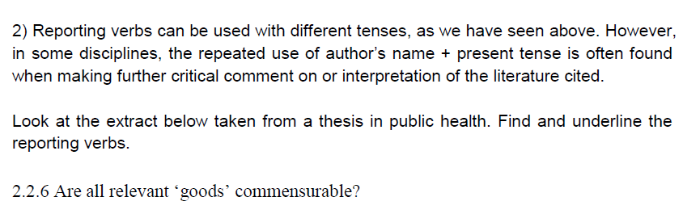
Tenses in Reporting Verbs

Slide 38
KEY
Wolff & De-Shalit (2007) suggest that a plausible monism (a single scale of measurement used for comparison) must adopt a ‘compensation paradigm’ (p25) and provide a formal argument against substitution monism (p26). Wolff & De-Shalit argue that no amount of money can…

Slide 39
Reporting verbs in “introductory it” clauses
(Hewings and Hewings 2002: 1)
A common perception of academic text is that its main purpose is to present information in an objective and impersonal way. One way of doing this is introductory it clauses, in which the subject is placed at the end of the clause and it inserted in the normal subject position, e.g.
a) That these results are provisional must be emphasized.
b) It must be emphasised that these results are provisional.
c) To acknowledge the differences is important.
d) It is important to acknowledge the differences.

Slide 40
There seem to be four main ways in which the writers use
it has been _______ that X:
1. Low-level topic priming: the writer introduces the topic and prepares the reader for what follows in the paragraph or section:
It has been supposed by some observers that most deforestation is quickly compensated for by regrowth, and that areas cleared and

Slide 41
2. Self referencing:
It has also been argued in the previous chapter that these singularities have similar properties to the fold singularities that occur for colliding impulsive waves as described in Section 8.2 in terms of the behaviour of neighbouring geodesics.

Slide 42
3. Bringing in outside information from a non-cited source:
It has been known for some years now that records of the electricity activity of the brain during sleep - by electrodes attached to the scalp, face and neck - confirm that different types of sleep exist.

Slide 43
4. Bringing in outside information from a cited source
It has been shown, for example, that levels of violence during industrial disputes fell in the first three-quarters of this century, but that this trend has been reversed more recently (Geary, 1985).

Slide 44
It-clauses and stance
The writer’s own opinion about the information introduced by this phrase may be positive, negative or neutral. Here is an example of a negative opinion:
It has been supposed by some observers that most deforestation is quickly compensated for by regrowth, and that areas cleared and then abandoned are soon covered with secondary forest. This conclusion is questionable, according to the survey’s findings.

Slide 45
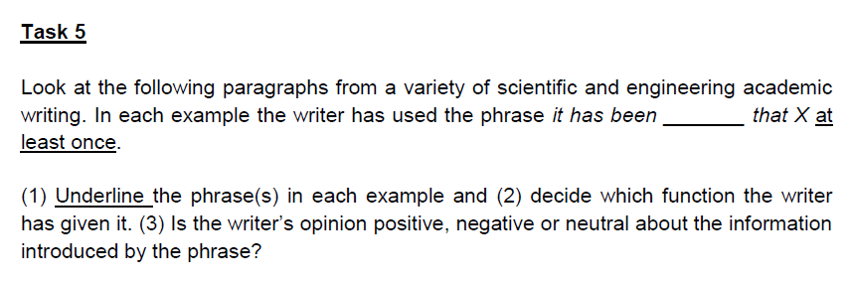
Task 5

Slide 46
Please enrol on the Canvas course
https://canvas.bham.ac.uk/enroll/PRCKWB
Materials and hand-outs (with keys) will be posted in Modules
Please contribute questions and observations on the ‘Discussion’ boards

Slide 47

Wednesday 3 June

